Slide 1
Healthcare Data Simulators
Viva Presentation

Slide 2
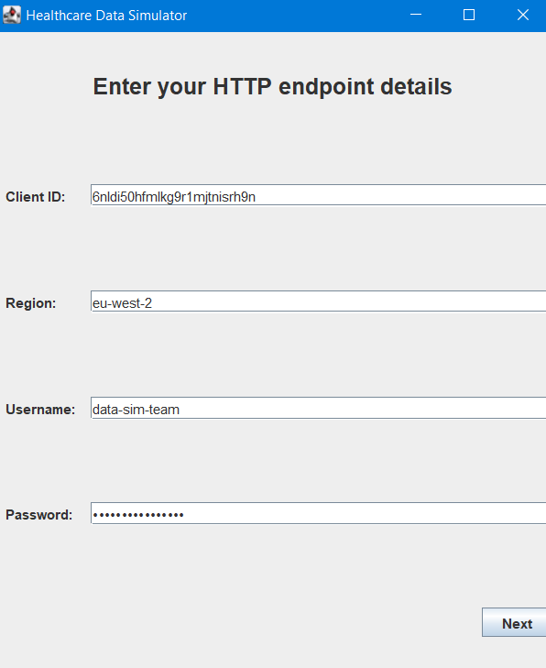
When running the app the first menu the user sees is regarding the OAuth credentials.
After entering connection details, clicking “Next”, the application will request a token from AWS Cognito in order to establish connection with the server.
If the credentials are correct and the token is received the user can start sending POST requests to the server.

Slide 3
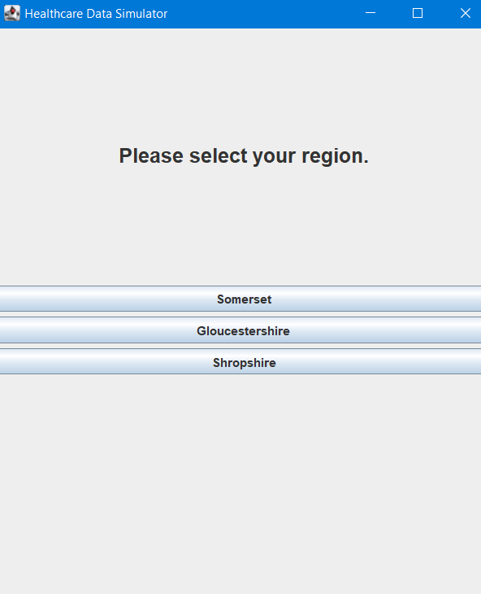
The following menu is related to the region the user wants to generate patients from. The region can either be Somerset, Gloucestershire or Shropshire.

Slide 4
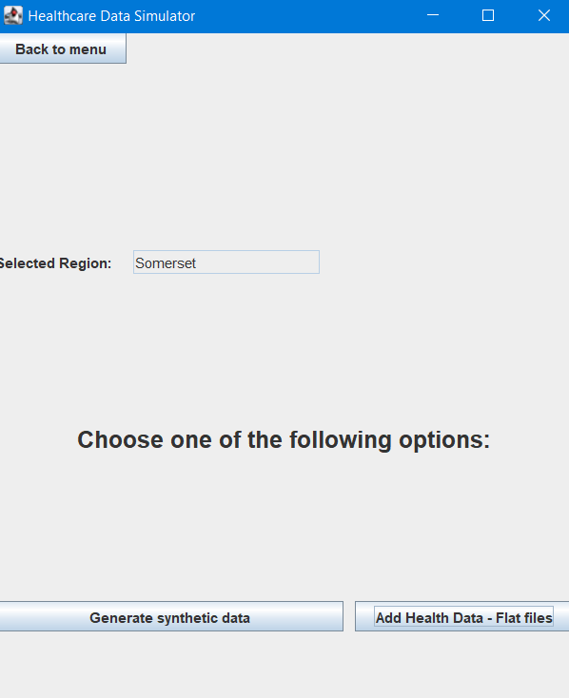
The next menu asks the user whether synthetic data about patients should be generated using the third party Synthea, or if flat files should be uploaded.

Slide 5
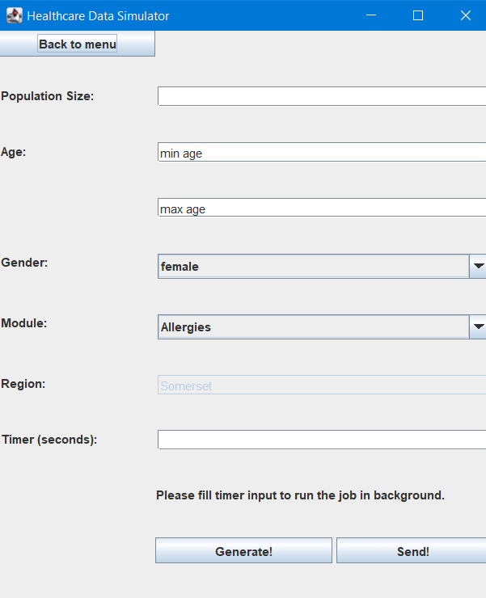
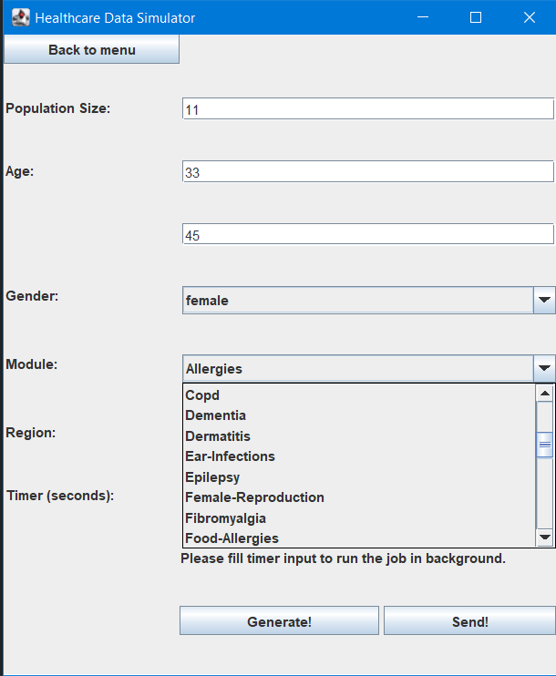
When choosing “Generate synthetic data”, the next menu should be filled with the characteristics the user wants the patients to have. These include number of patients (population size), age range, gender, diseases (module) and the region previously selected.

Slide 6
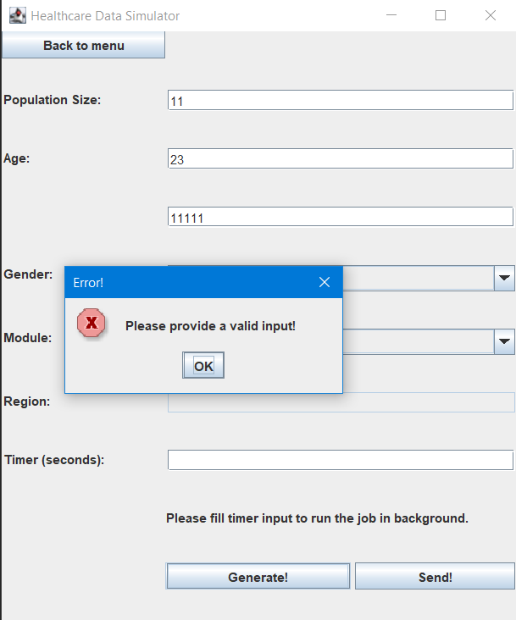
If one or more of these fields does not have a correct input, the user is notified.

Slide 7


We have implemented a scheduler (cron-job) for our application using a library called “Quartz”. This is useful when the user wishes to send data about patients to Rabbit queues in a continuous fashion. RabbitMQ is an open source message broker technology which allows the deployment of data in the cloud, provides decoupling between producers and consumers and facilitates data separation meeting high-scale requirements.

Slide 8
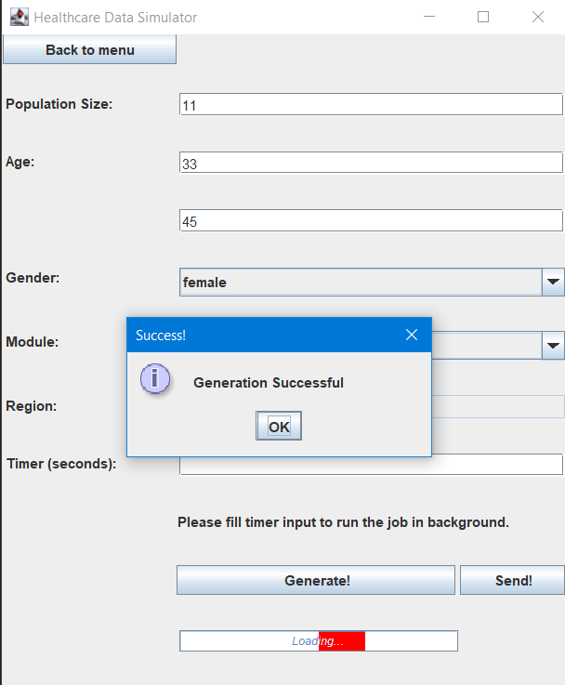
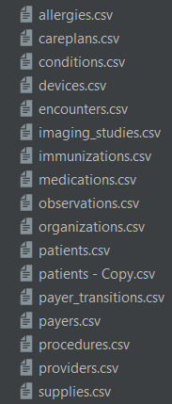
If the user does not fill the timer label, then, only one chunk of data will be generated and sent. The progress bar present in our GUI notifies the user that Synthea is running behind the curtains. All the resources that we read and place into Rabbit queues are CSVs. On the right side you can see the resources produced by Synthea:

Slide 9
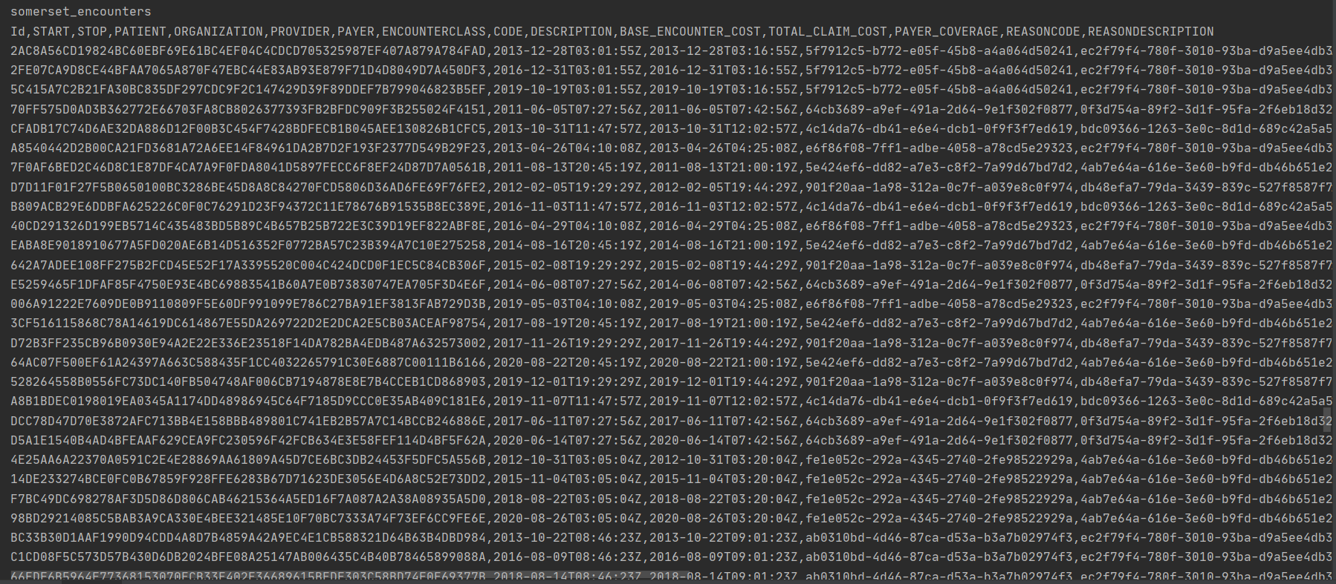
One more requirement our client demanded was the encryption of sensitive data, namely the NHS number of the patients using a service called OpenPseudomiser. OpenPseudomiser masks data using a salt. When pressing “Send!”, the NHS number for all patients is masked and all the resources are sent into suitable Rabbit queues. Here is a picture of my terminal with some of the resources that are sent.

Slide 10
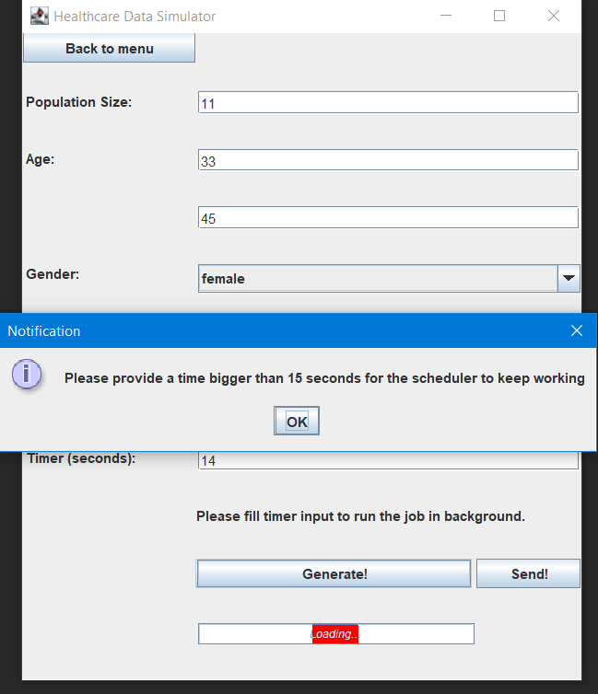
If the user introduces a time for the scheduler, then the cron-job will start running in background. The minimum amount of time is 15 seconds, the user being notified about this.

Slide 11
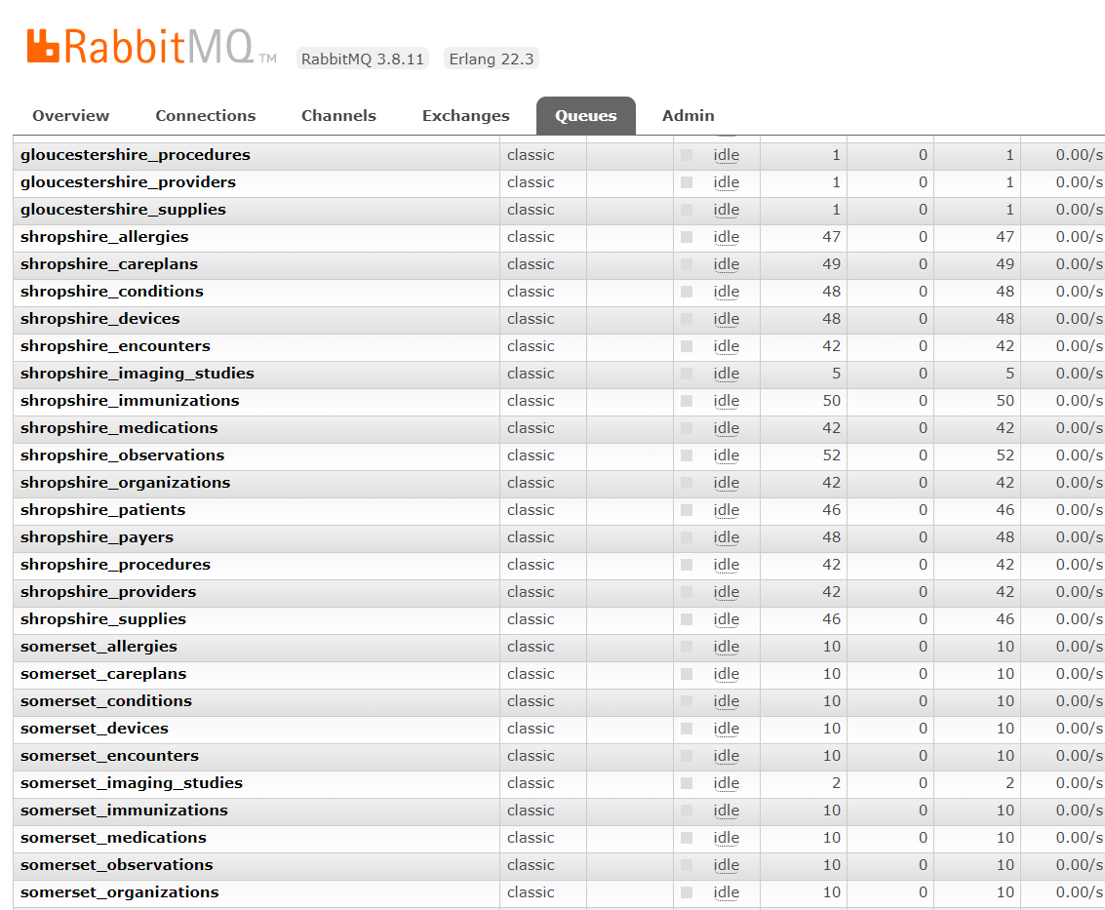
The cron-job manages the whole flow of the application. The application will generate resources using Synthea, read these resources (which are in CSV format), mask the NHS number and send these CSVs into suitable Rabbit queues repeatedly at each interval inputted by the user. This picture taken from the Rabbit UI shows the queues we have created for each region and resource.

Slide 12
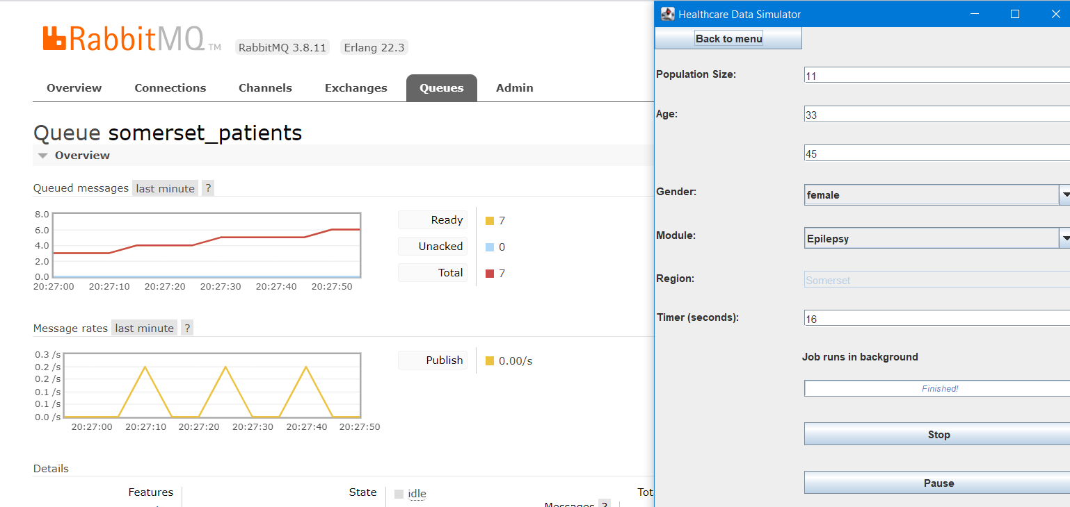
This shows the flow of data being pushed on one of the queues every 16 seconds.

Slide 13
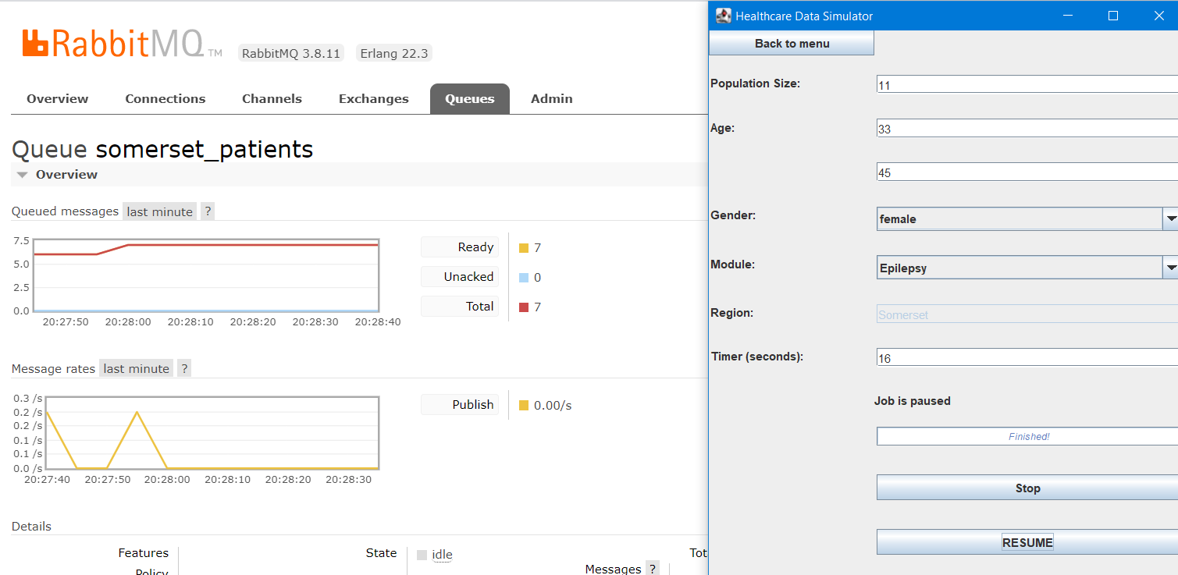
The application can be paused or resumed, the user being notified about this. We can again check this behavior using the Rabbit interface which shows the flow of data being pushed on one of the queues.

Slide 14
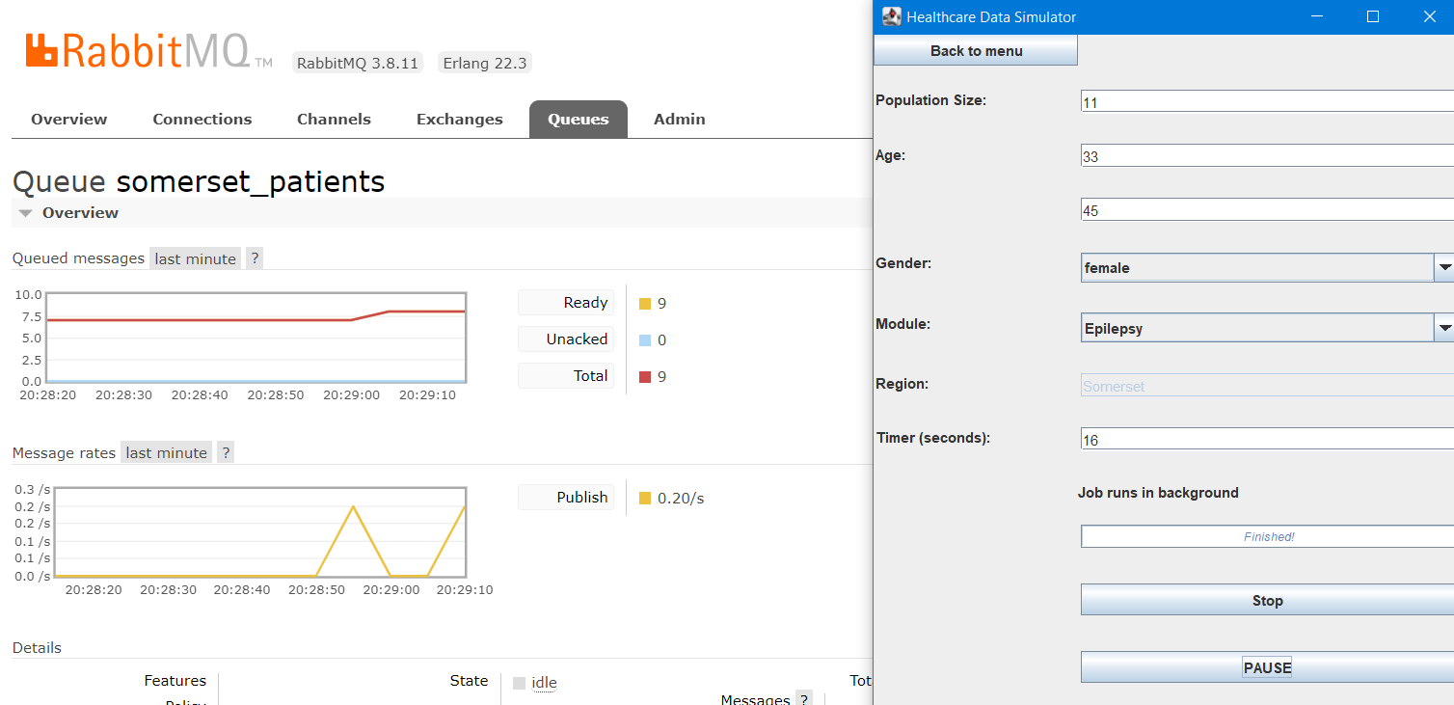

Slide 15
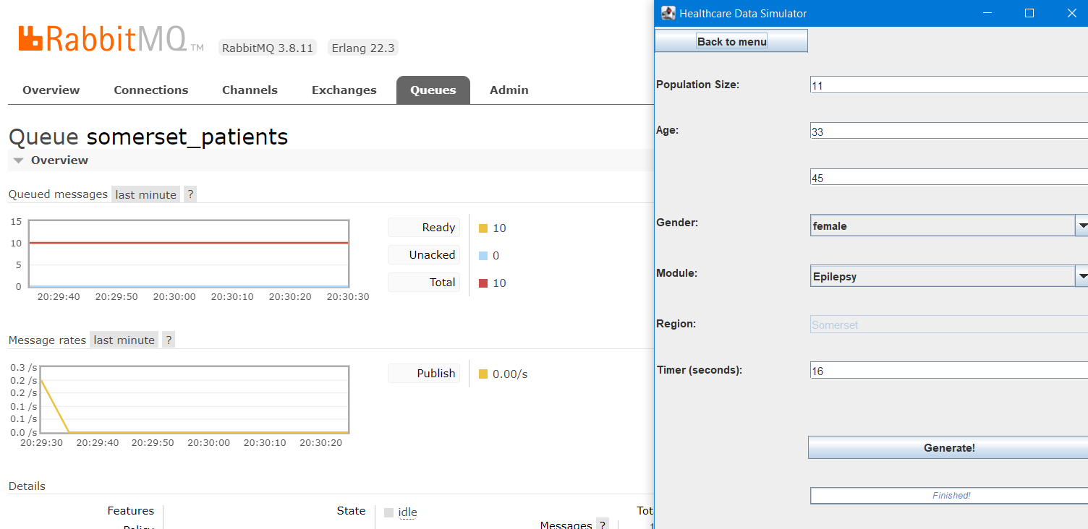
In the end, the application can be shut down.

Slide 16
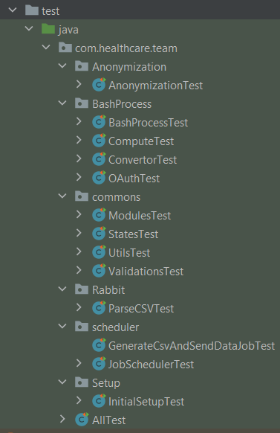
In order to test our work we have written JUnit tests for the entire application and we have tested their coverage using JaCoCo.

